Slide 1
Object Oriented Programming I: Lecture 6 Operator Overloading
Ahmed Imteaj
Lecturer
Dept. of CSE, IIUC

Slide 2
Operator Overloading
In programming, operator overloading is a specific case of polymorphism, where different operators have different implementations depending on their arguments.

Slide 3
Binary Operator Overloading
Overloading with a single parameter is called binary operator overloading. Binary operators requires two operands, and they are overloaded by using member functions and friend functions.
Binary operators are very frequently used like addition (+) operator, subtraction (-) operator and division (/) operator.

Slide 4
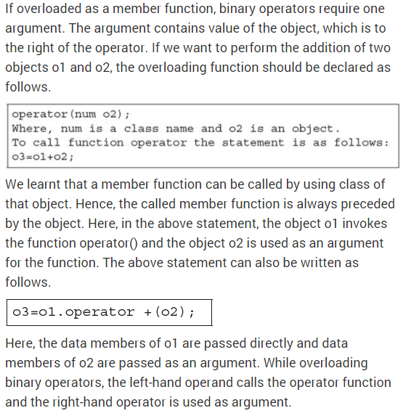
Binary Operator Overloading using Member functions

Slide 5
Binary Operator Overloading using Member functions
#include<iostream>
using namespace std;
class complex
{int a,b;
public:
void getvalue()
{cout<<"Enter value of a,b:";
>>a>>b;}
complex operator+(complex ob)
{
complex t;
t.a=a+ob.a;
t.b=b+ob.b;
return(t);
}
void display()
{
cout<<a<<"+"<<b<<"i"<<"\n";
}
};
int main()
{
complex obj1,obj2,result,result1;
obj1.getvalue();
obj2.getvalue();
result = obj1+obj2;
cout<<"\nResult:\n";
result.display();
return 0;
}

Slide 6
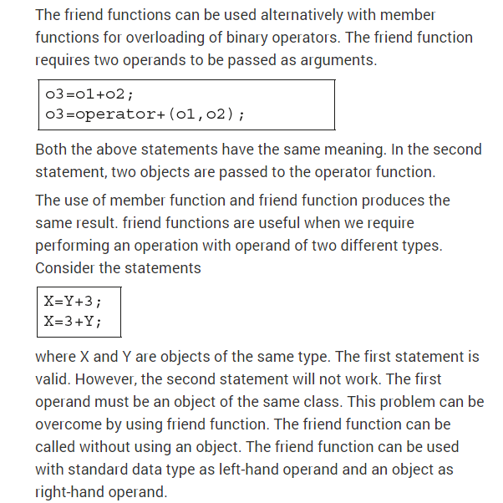
Binary Operator Overloading using Friend functions

Slide 7
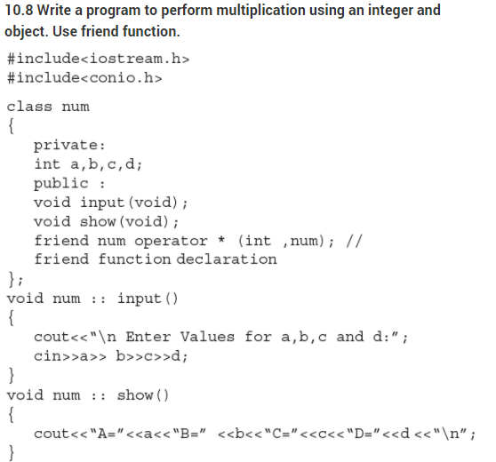
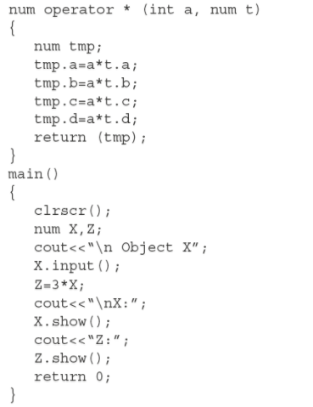
Binary Operator Overloading using Friend functions

Slide 8
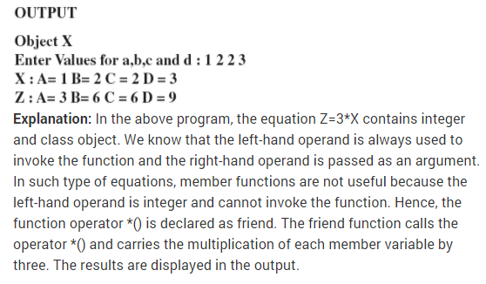
Binary Operator Overloading using Friend functions

Slide 9
Unary Operator Overloading
Unary operators act on only one operand. (An operand is simply a variable acted on by an operator.)
Examples of unary operators are the increment and decrement operators ++ and --,

Slide 10
Unary Operator Overloading
#include <iostream>
using namespace std;
class Counter
{
private:
int count;
public:
Counter() : count(0) //constructor
{ }
int get_count()
{ return count; }
void operator ++ ()
{ ++count;
}
};
int main()
{
Counter c1, c2;
cout << "\nc1=" << c1.get_count();
cout << "\nc2=" << c2.get_count();
++c1; //increment c1
++c2; //increment c2
++c2; //increment c2
cout << "\nc1=" << c1.get_count();
cout << "\nc2=" << c2.get_count() << endl;
return 0;
}

Slide 11
Relational and Logical Operator Overloading
There are various relational operators supported by C++ language like (<, >, <=, >=, ==, etc.) which can be used to compare C++ built-in data types.
You can overload any of these operators, which can be used to compare the objects of a class.
Following example explains how a < operator can be overloaded and similar way you can overload other relational operators.

Slide 12
Relational and Logical Operator Overloading
#include <iostream>
using namespace std;
class Distance {
private:
int feet; // 0 to infinite
int inches; // 0 to 12
public:
Distance(int f, int i){
feet = f;
inches = i;
}
// overloaded < operator
bool operator <(Distance d) {
if(feet < d.feet) {
return true; }
if(feet == d.feet && inches < d.inches) {
return true;}
return false;}
};
int main() {
Distance D1(11, 10), D2(5, 11);
if( D1 < D2 ) {
cout << "D1 is less than D2 " << endl;
} else {
cout << "D2 is less than D1 " << endl;
}
return 0;}

Slide 13
Limitations of Operator Overloading
Precedence and Associativity of an operator cannot be changed.
Numbers of Operands cannot be changed. Unary operator remains unary, binary remains binary etc.
No new operators can be created, only existing operators can be overloaded. Few operators like ::, sizeof, ?: etc. can not be overloaded.
Cannot redefine the meaning of a procedure. You cannot change how integers are added.

Slide 14
Thank You!!

